Slide 1
Learning Based Real-Time Object Tracking through Motion Vector Predictions on Motion Blur
Mingze Sun, Jiacheng Huang

Slide 2
Introduction
Motion blur significantly affects the accuracy of current tracking systems.
Existing solutions like the SSD tracker, despite robustness, fall short in high-motion scenarios due to motion blur.

Slide 3
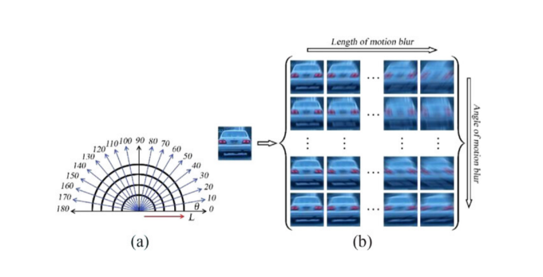
Methodology
Generate 270 different motion kernels based on the motion direction θ and magnitude l.

Slide 4
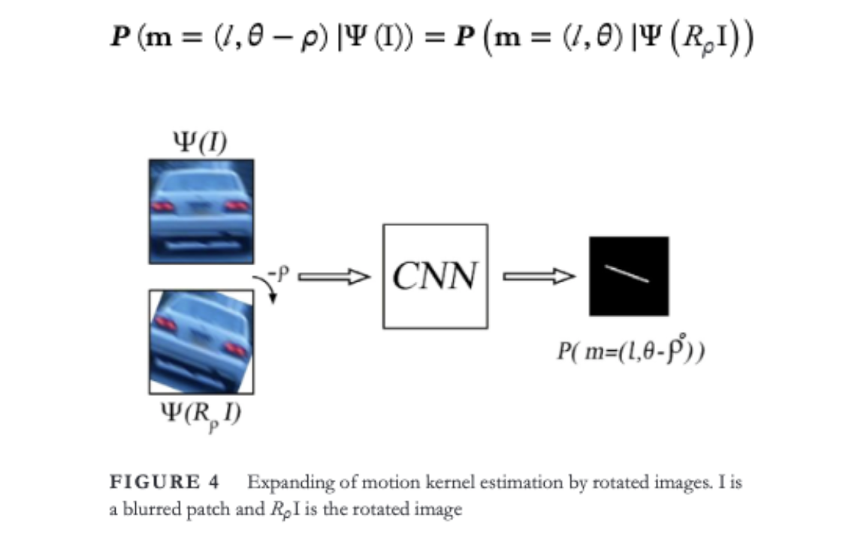
Methodolody
270 motion kernel candidates are not sufficient during the tracking.
The probabilities of motion kernels for the rotated patches of every image can be estimated by feeding the rotated patch into CNN

Slide 5
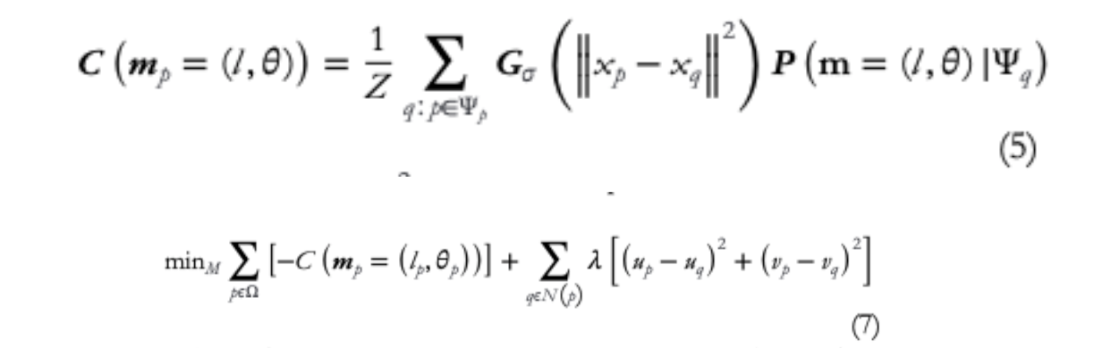
Methodology
Define the confidence of the motion kernel among multiple estimated motion probabilities.
Then we estimate the dense motion field by optimizing the following MRF model:

